Slide 1

CUDA streams
Lara Querciagrossa, Andrew Emerson, Nitin Shukla, Luca Ferraro, Sergio Orlandini
l.querciagrossa@cineca.it
July 12th, 2022

Slide 2


In this lecture…
Streams
Streams behavior
Using streams

Slide 3


Streams

Slide 4
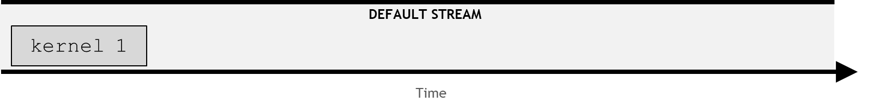
Streams
A stream is a series of commands (kernel execution and memory transfer) that execute in order.
If no explicit CUDA stream has been specified, CUDA kernels are executed in a default stream.
Non-default CUDA streams can be used to perform multiple operation concurrently in different streams.
Notes:
Register = small amount of fast storage

Slide 5
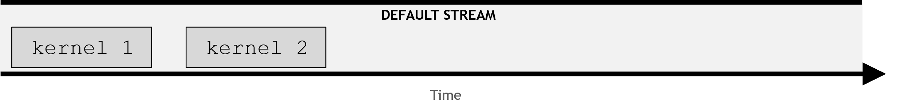
Streams
In any stream, both default and not, instructions execute in order: an instruction must be completed before the next one can begin.
Notes:
Register = small amount of fast storage

Slide 6
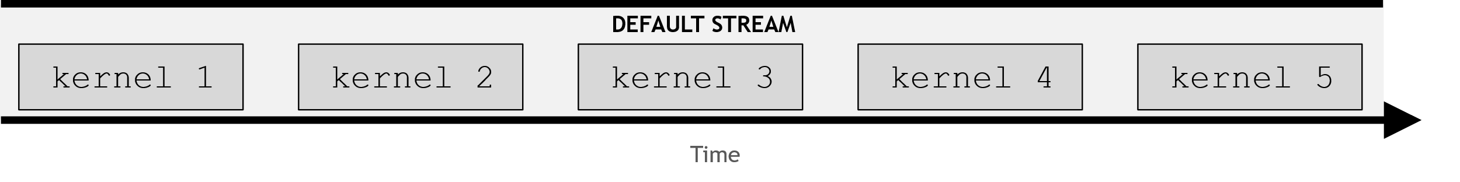
Streams
In any stream, both default and not, instructions execute in order: an instruction must be completed before the next one can begin.
Notes:
Register = small amount of fast storage

Slide 7
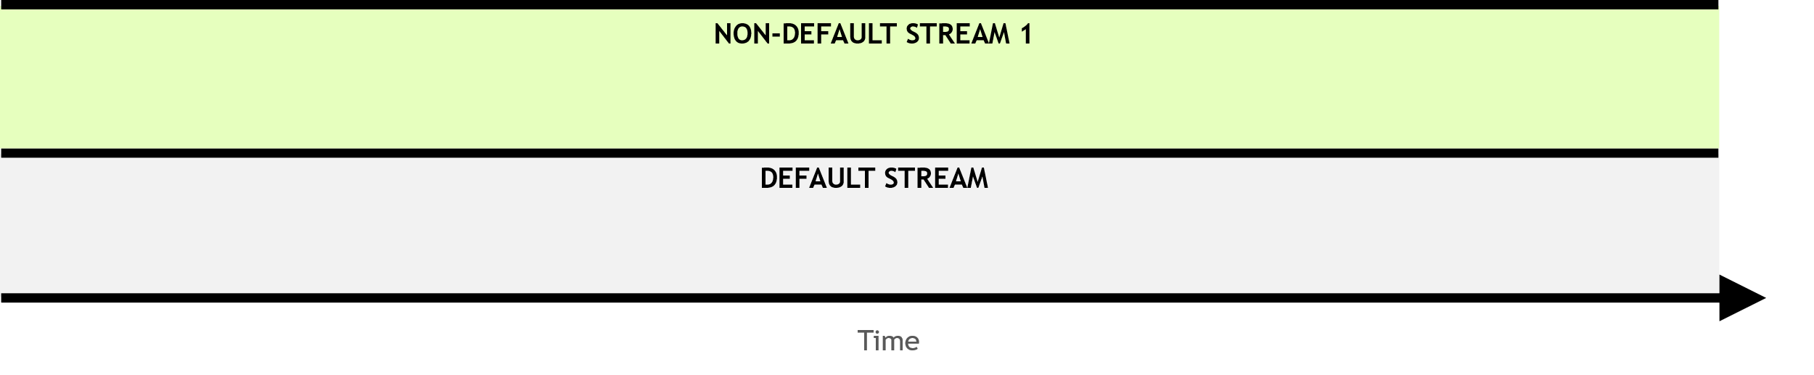
Streams
Additional non-default streams can be created for kernel execution.
Notes:
Register = small amount of fast storage

Slide 8
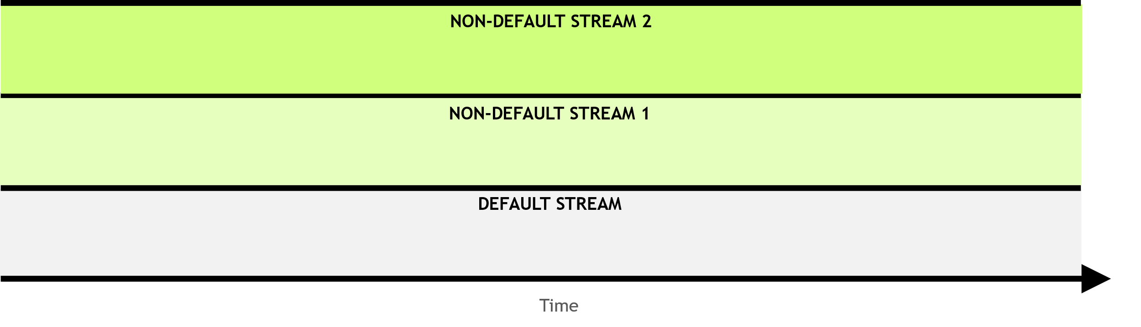
Streams
Additional non-default streams can be created for kernel execution.
Notes:
Register = small amount of fast storage

Slide 9
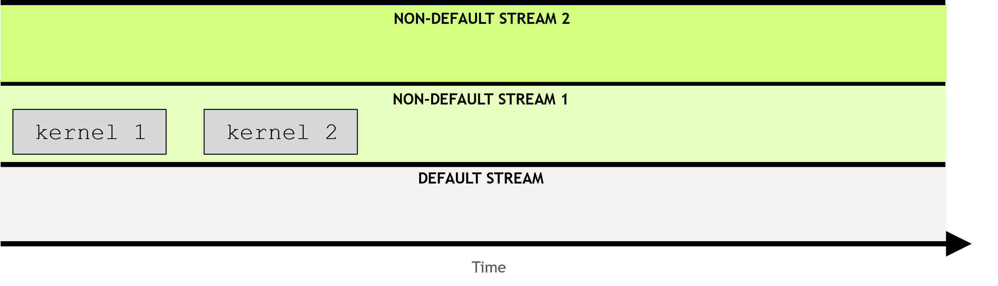
Streams
Kernels in non-default must execute in order as well.
Notes:
Register = small amount of fast storage

Slide 10
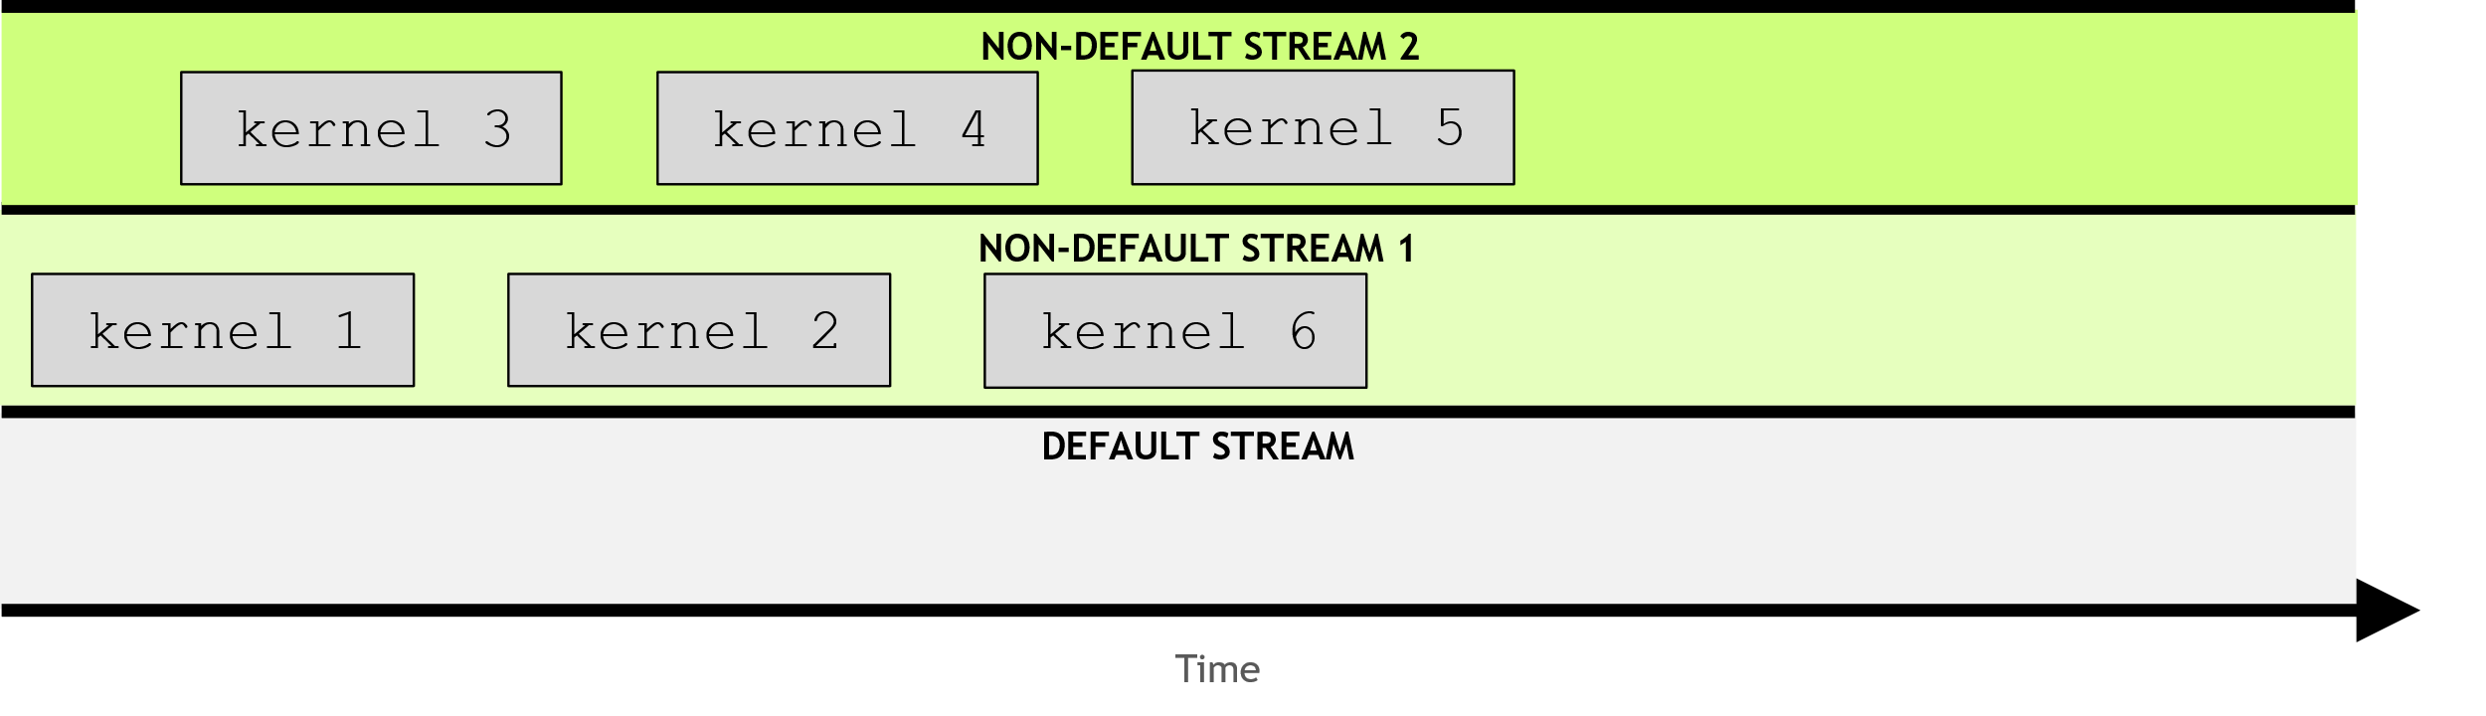
Streams
But! Kernels in different non-default streams can interact concurrently.
Notes:
Register = small amount of fast storage

Slide 11
Streams behavior

Slide 12
Rules governing the behavior of streams
Operations within a given stream occurs in order.
Notes:
Register = small amount of fast storage

Slide 13
Rules governing the behavior of streams
Operations within a given stream occurs in order.
Operations in different non-default streams are not guaranteed to operate in any specific order relative to each other.
Notes:
Register = small amount of fast storage

Slide 14
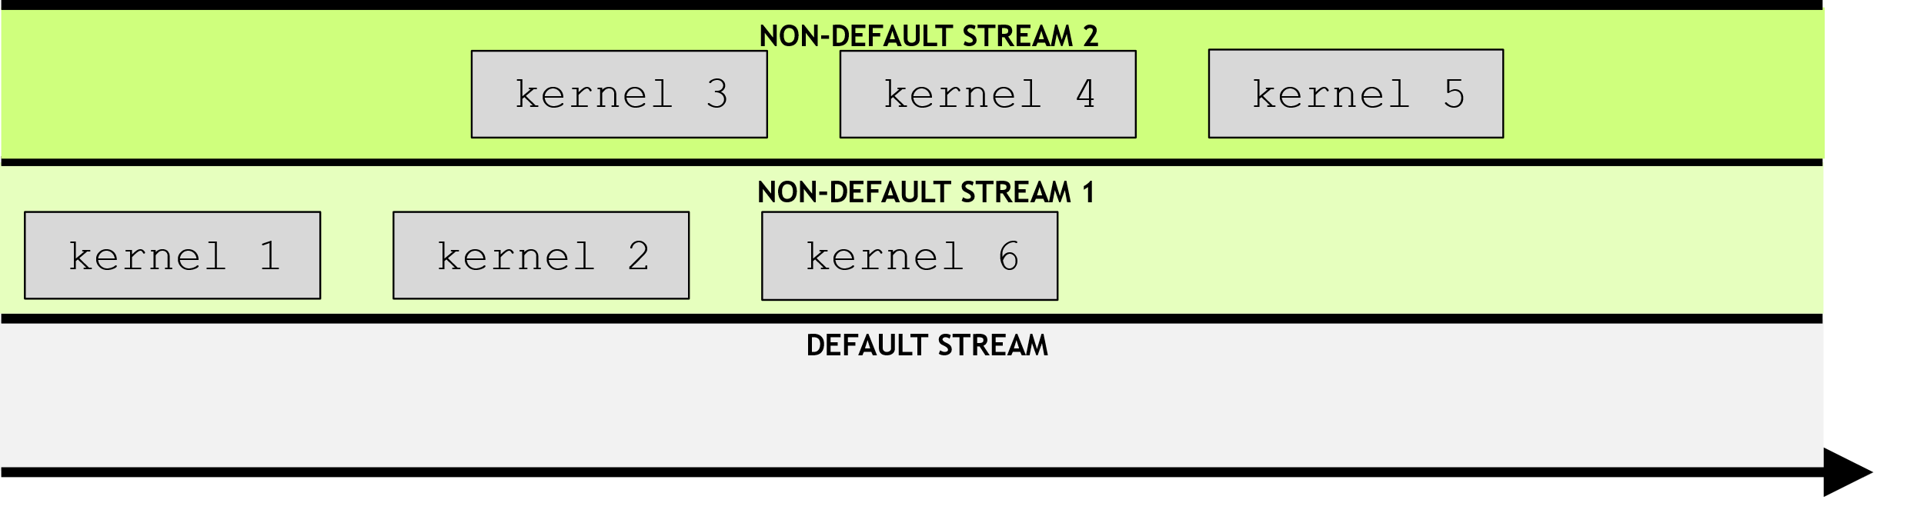
Rules governing the behavior of streams
Operations within a given stream occurs in order.
Operations in different non-default streams are not guaranteed to operate in any specific order relative to each other.
Notes:
Register = small amount of fast storage

Slide 15
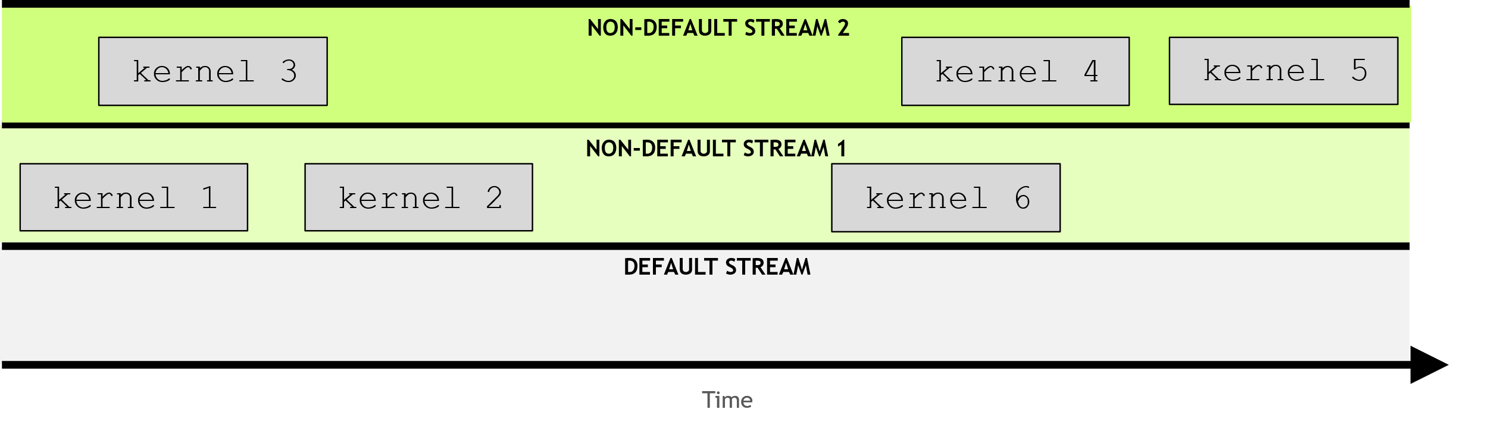
Rules governing the behavior of streams
Operations within a given stream occurs in order.
Operations in different non-default streams are not guaranteed to operate in any specific order relative to each other.
Notes:
Register = small amount of fast storage

Slide 16
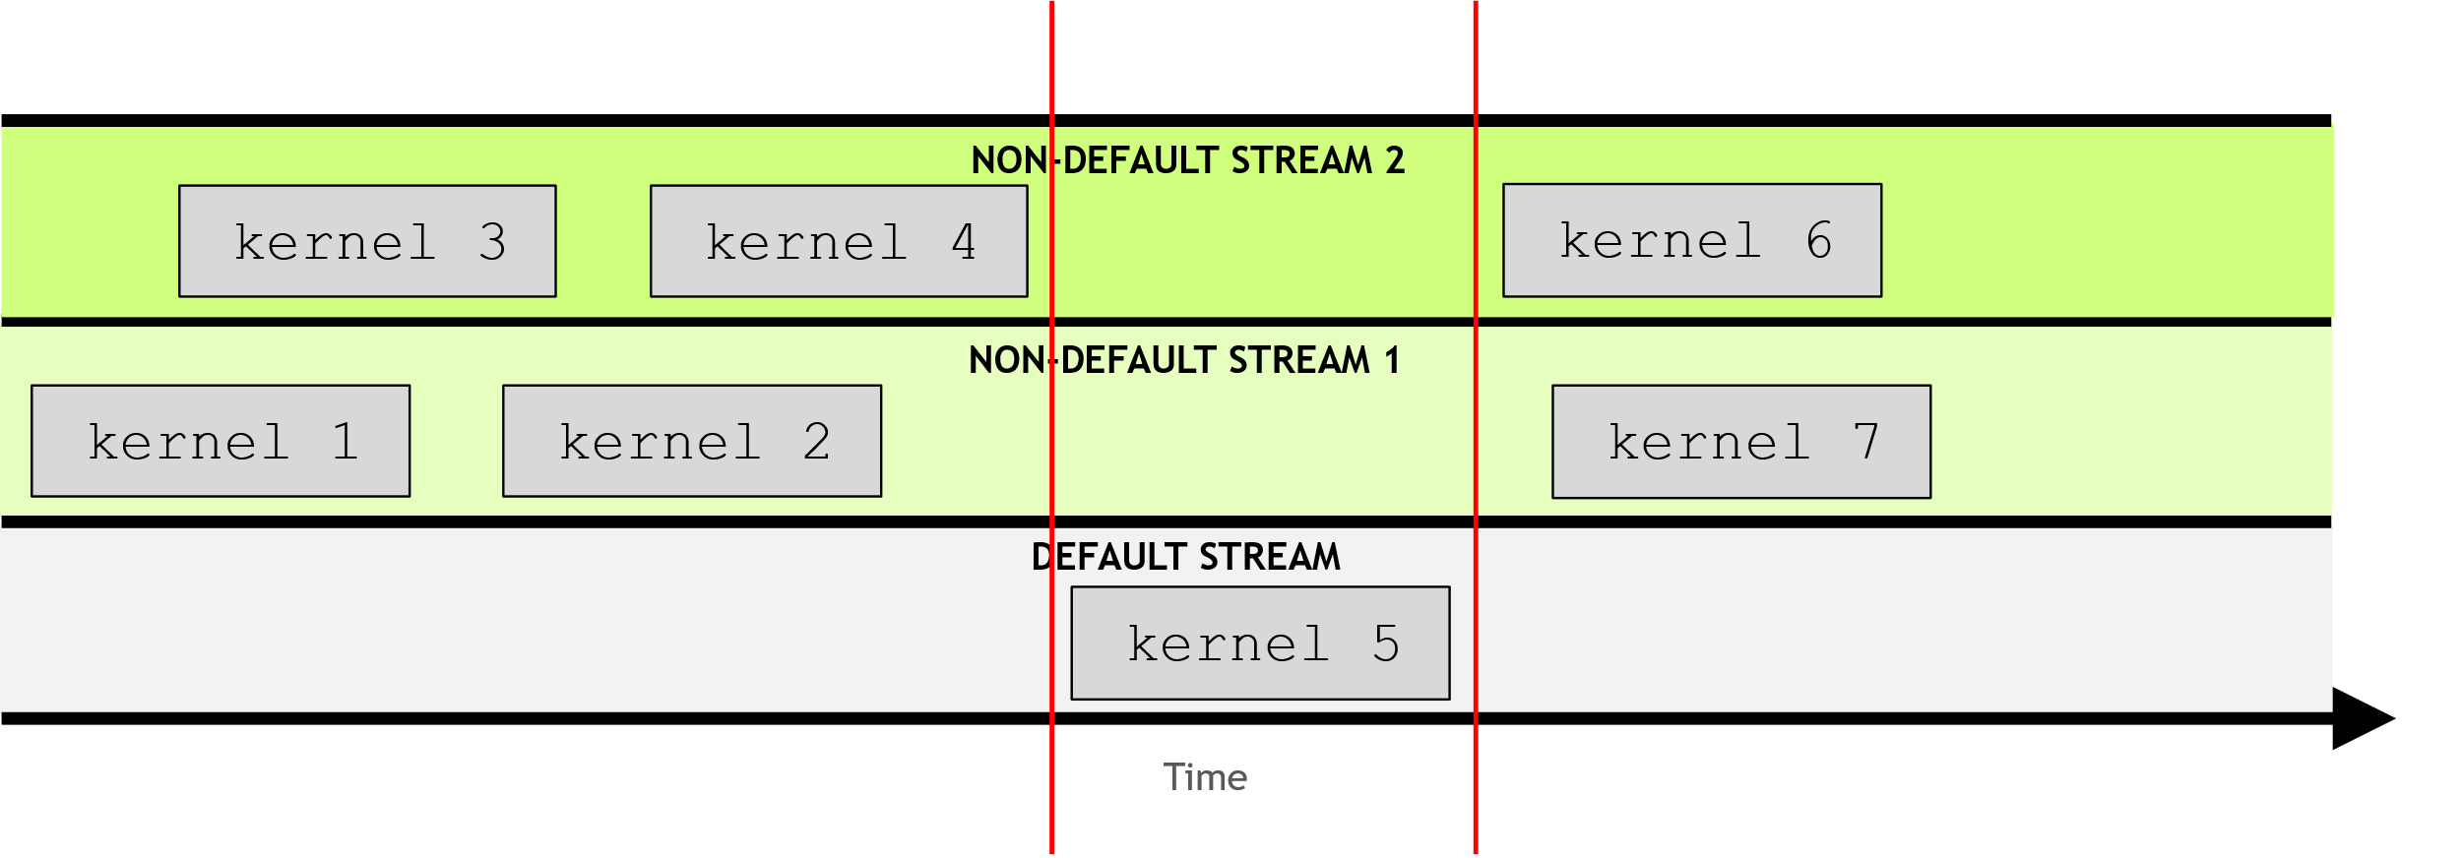
Rules governing the behavior of streams
Operations within a given stream occurs in order.
Operations in different non-default streams are not guaranteed to operate in any specific order relative to each other.
The default stream is blocking and will both wait for all other streams to complete before running, and, will block other streams from running until it completes.
Notes:
Register = small amount of fast storage

Slide 17
Using streams

Slide 18
Creating, using and destroying non-default streams
CUDA streams should be created as follows:
cudaStream_t stream;
cudaStreamCreate(&stream);
To launch a CUDA kernel in a non-default CUDA stream a 4th argument should be passed to the execution configuration
someKernel<<<number_of_blocks, threads_per_block, 0, stream>>>();
CUDA non-default streams should be destroyed when not used.
cudaStreamDestroy(stream);
pointer
Off-topic: number of bytes of shared memory (small and fast memory mounted on each SM) to be dynamically allocated per block
value
Notes:
Register = small amount of fast storage

Slide 19
Exercise: 19_print_number_streams.cu
This exercise starts from a very simple printNumber kernel which accepts an integer and prints it. The kernel is being executed 5 times, using a for-loop, and passing each launch the number of the for-loop's iteration. These iterations run serially since they are in the default stream (which shows a blocking behavior).
Refactor the code so that each kernel launch occurs in its own non-default streams.
Will kernels now run in parallel?
Notes:
Register = small amount of fast storage

Slide 20
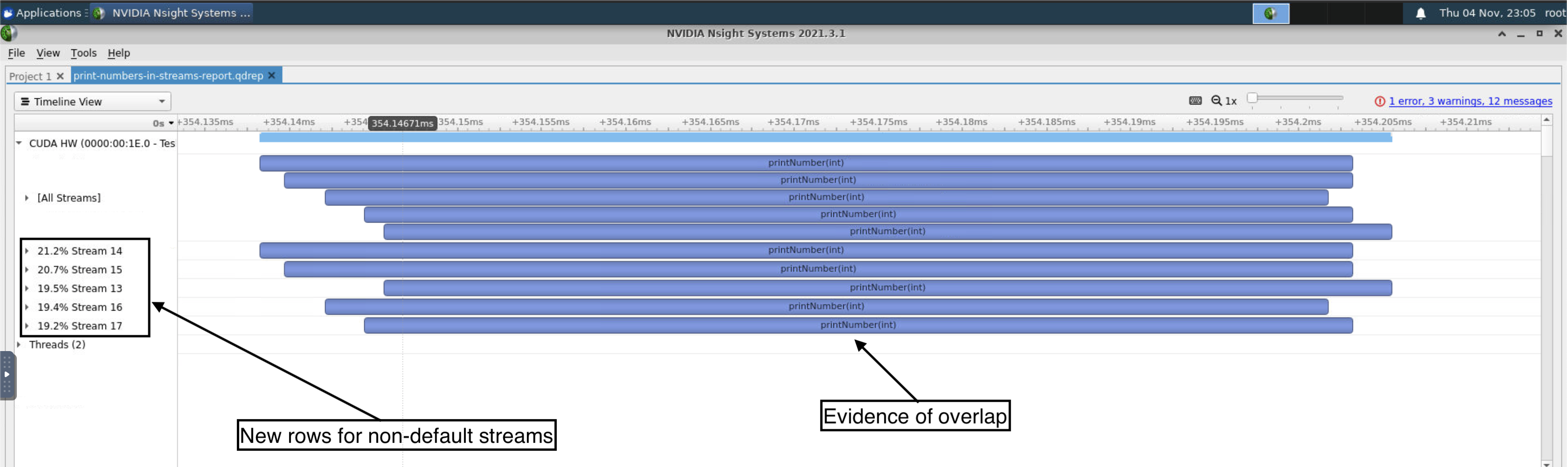
Exercise: 19_print_number_streams.cu
In the next days you will learn how to inspect the profile with Nsight System.
Notes:
Register = small amount of fast storage

Slide 21
Exercise: 20_vector_add_streams.cu
The starting point of this exercise is vector addition application you have been working on in exercises 11, 15 and 17.
Currently, it launches an initialization kernel 3 times, once each for each of the 3 vectors needed in the vectorAdd kernel.
Refactor it to launch each of the 3 initialization kernel launches in their own non-default stream.
Be sure to still see the success message print when compiling and running your solution.
In the next days you will learn how to inspect the profile with Nsight System.

Slide 22
References

Slide 23

References
Previous editions of this school at CINECA
Oakridge National Laboratory’s “Introduction to CUDA C++”: https://www.olcf.ornl.gov/calendar/introduction-to-cuda-c/
NVIDIA DL Institute Online Course: main source of exercises
www.computerhope.com/jargon/p/pagefaul.htm
blogs.nvidia.com
Wikipedia

Slide 24
THANK YOU!
Lara Querciagrossa
l.querciagrossa@cineca.it

